Slide 1

Introduction to Jenkins

Slide 2
Agenda
Introduction
Install Jenkins
Run Jenkins Job
Git, Github
MSBuild, Nuget, Nunit
Unit tests
MSBuild Warnings
SMTP/Email
Pipeline
Master Slave

Slide 3
Introduction
What is Continuous Integration?
The practice of merging all developer working copies to a shared machine.
Why Continuous Integration?
Detect bugs as early as possible

Slide 4
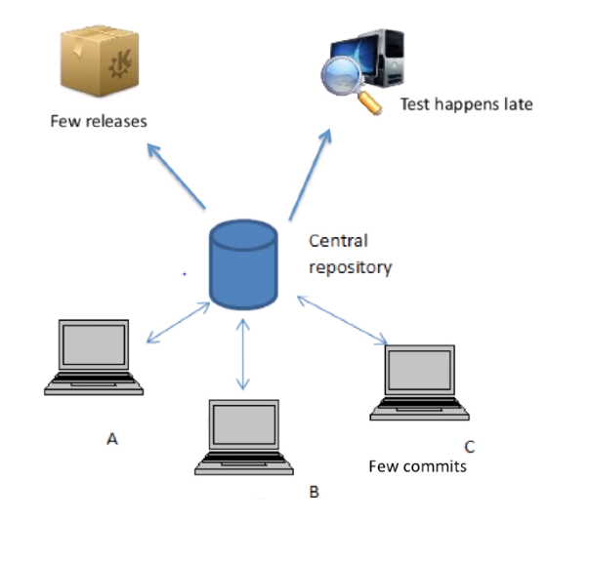
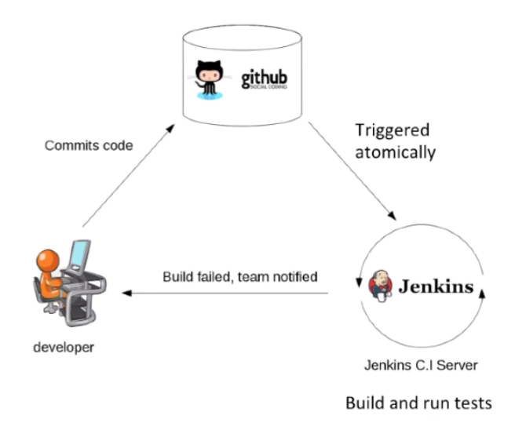
Introduction

Slide 5
Introduction
Continuous Integration
Merging development work.
Continuous Delivery
Delivery of code to an environment.
Continuous Deployment
Release of code to production.

Slide 6

Some other CI servers
CircleCI
TravisCI

Slide 7

The History of Jenkins
Hudson was started in 2004 by Kohsuke Kawaguchi as a hobby project.
First release in 2005
Became the leading Continuous Integration Solution in 2010
Renamed to Jenkins in 2011

Slide 8
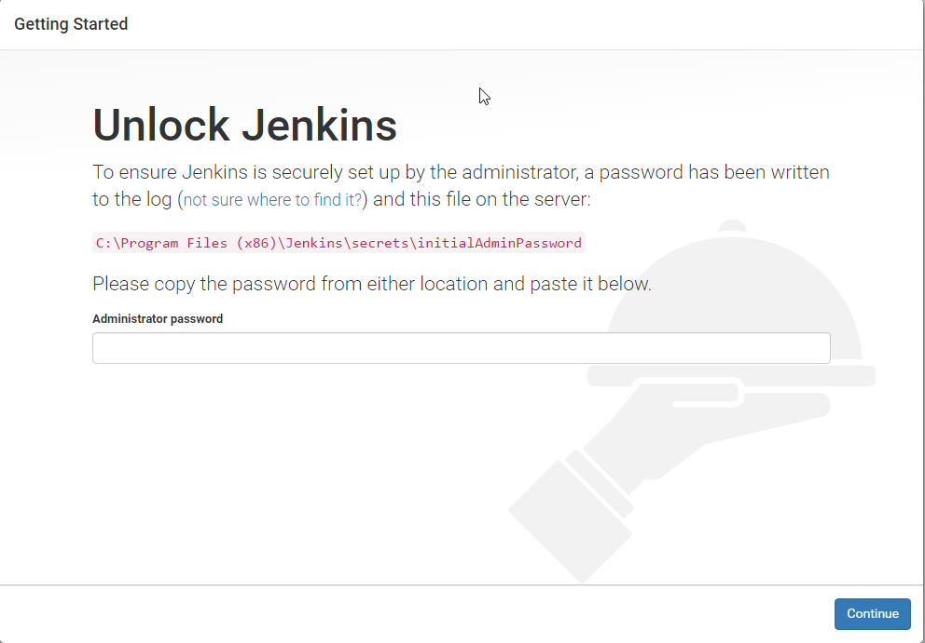
Install Jenkins
Go to https://jenkins.io/ and download Jenkins
Install Jenkins, then go to http://localhost:8080
Follow the instruction to login

Slide 9
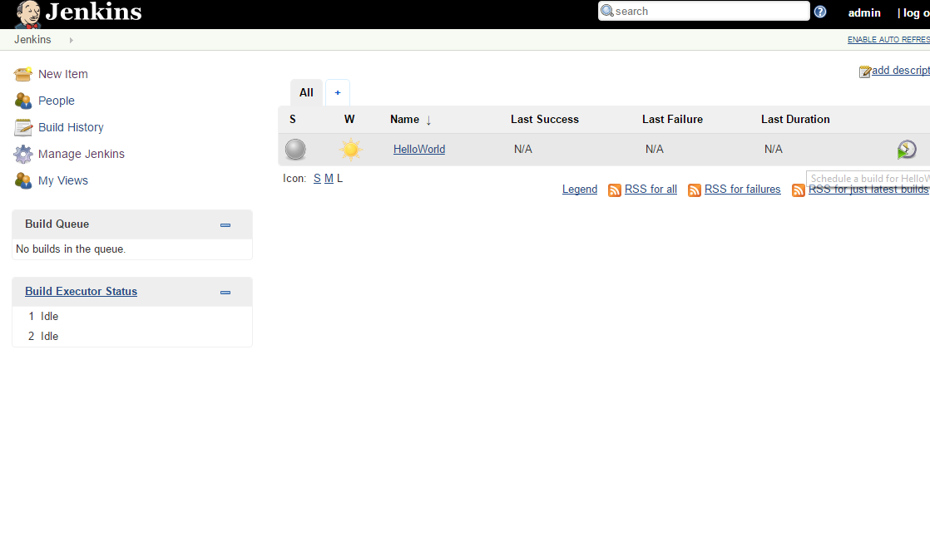
Run Jenkins Job

Slide 10
Practices
Git, Github
MSBuild, Nuget, Nunit
Unit tests
MSBuild Warnings
SMTP/Email
Pipeline

Slide 11
Master/Slave
Master
Schedule build jobs
Dispatch builds to the slaves
Slave:
Execute jobs dispatched by the master

Slide 12
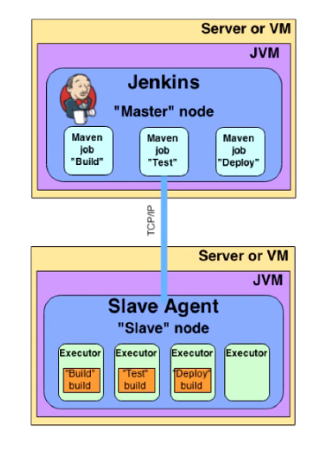
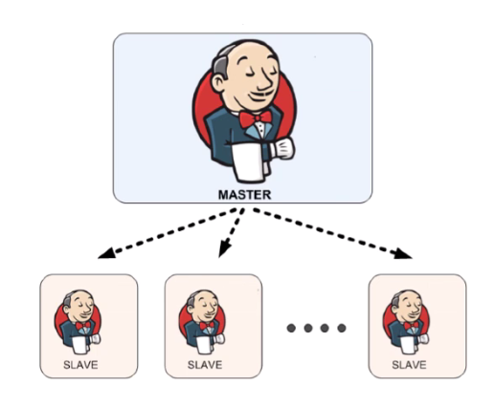
Master/Slave

Slide 13
Set up with two Linux servers
Master: Install Jenkins
wget -q -0 - http://pkg.jenkins-ci.org/debian/jenkins-ci.org.key | apt-get add -
echo deb http://pkg.jenkins-ci.org/debian binary/ > /etc/apt/sources.list.d/jenkins.list
apt-get update
apt-get install jenkins
Slave: Create SSH key
sudo -iu jenkins
ssh-keygen -t rsa
the key: /var/lib/jenkins/.ssh/id_rsa
identification: /var/lib/jenkins/.ssh/id_rsa
public key: /var/lib/jenkins/.ssh/id_rsa.pub
master: Configure SSH credential
ssh root@slave mkdir -p .ssh
cat .ssh/id_rsa.pub | ssh root@slave 'cat >> .ssh/authorized_keys'
slave: Configure Slave node
mkdir bin
cd bin/
wget http://master:8080/jnlpJars/slave.jar
sudo apt-get update
sudo apt-get install default-jre

Slide 14
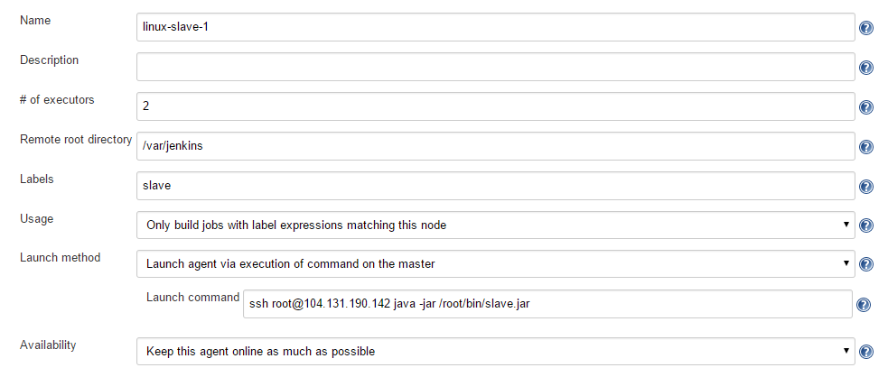
Set up with two Linux servers

Slide 15


Slide 16
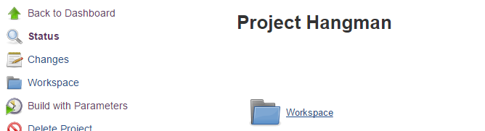
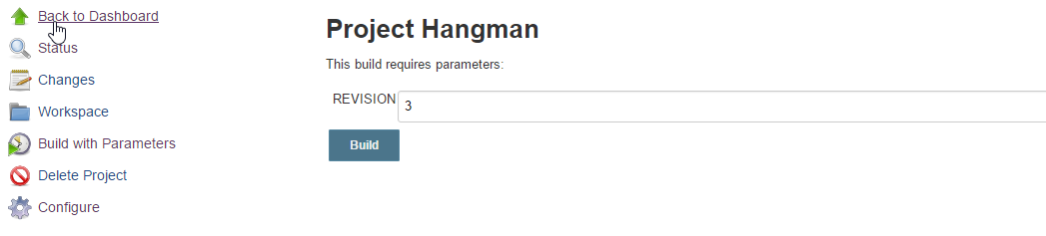
Final Practice
Build this C# project
https://subversion.assembla.com/svn/hangmanc-/trunk
Prompt the user for a revision number to build
Plugin: Global Variable String Parameter

